Slide 1
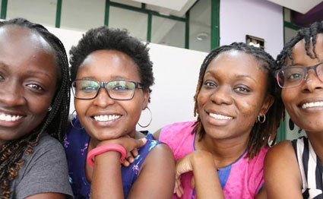

MY FIRST EXPERIENCE IN AKIRACHIX
It was fun and I was happy to be in a good, conducive and beautiful environment with ladies empowering and supporting their fellow ladies. Actually by Being open minded and caring.
#SHE BUILDS
#SHE SERVES
#SHE LEADS

Slide 2
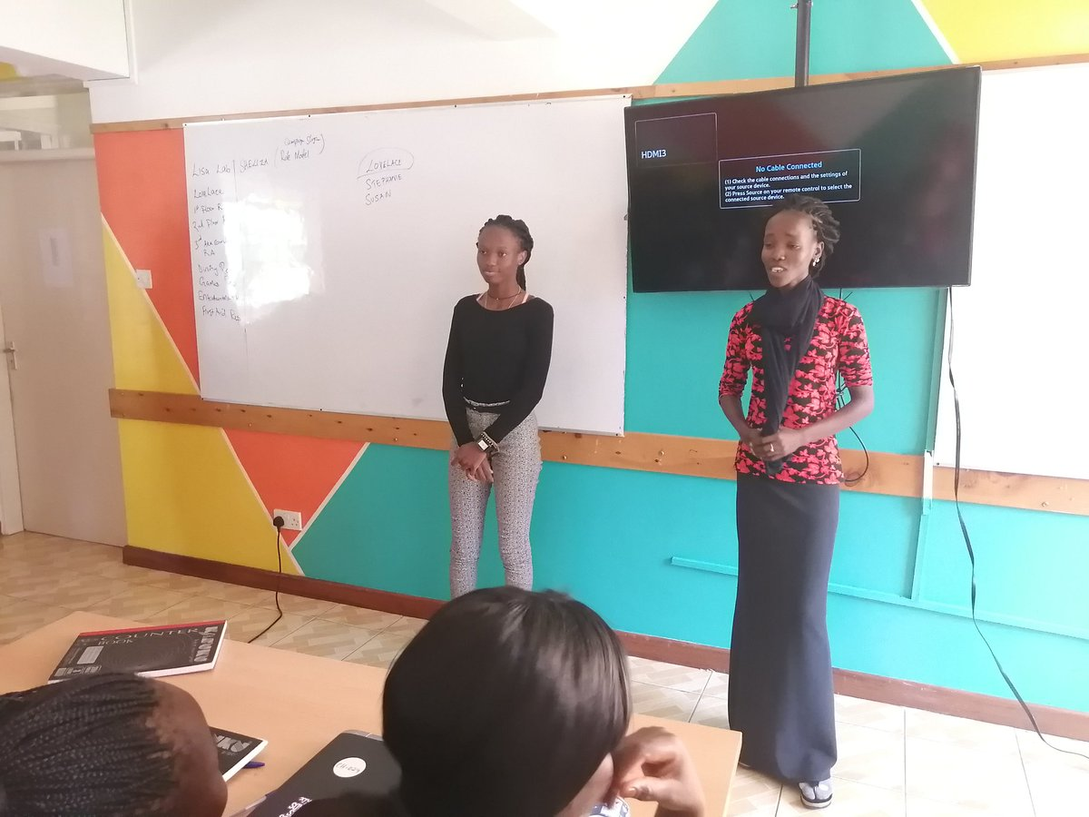
leadership
I interacted with some of the new student and learned some things based on where they came from and the way of life.

Slide 3

Learning environment
Its was fun learning new and Greek words like coding, and I became part of it.

Slide 4

HOSPITALITY
Actually AkiraChix is home far away from home with Best rooms & hot showers,( a video)

Slide 5
Self awareness
Actually the experience made me a better person since I knew my weaknesses, strength and values.

Slide 6
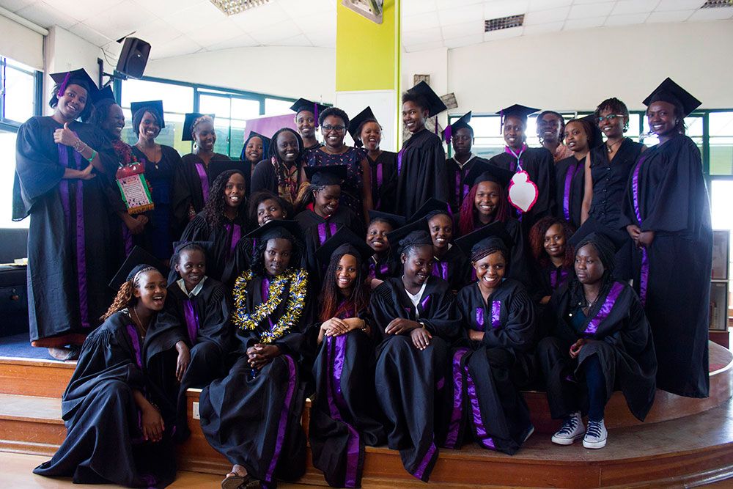

AM HOPING FOR THE BEST AND GOOD END

Slide 7
Don’t stop chasing the best version of you.
Thank you.

